Slide 1

Cloud Computing (Amazon Web Services)
Dr. Khurram S. Khattak (Certified AWS Architect & SysOps Admin)
Dept. of Computer Systems Engineering, UET Peshawar

Slide 2
Course Content
Week 1: Introduction to CC & AWS
Week 2: EC2 Essentials
Week 3: Storage & Content Delivery
Week 4: IAM & Security
Week 5: AWS Networking
Week 6: AWS Virtual Private Cloud
Week 7: AWS Elastic Load Balancer
Week 8: AWS Autoscaling
Week 9: AWS SysOps (CloudWatch, SNS,
SQS, SWF)
Week 10: AWS Cloud Formation
Week 11: AWS IoT & Simulator
Week 12: AWS Analytics
Week 13: AWS Deployment
Week 14: Specialized Topic
Week 15: Project
Week 16: Project

Slide 3
Content
What is Cloud Computing.
Different Cloud Computing Deployment Models.
Type of Services Provided by Cloud Platforms
General Cloud Architecture
Why Cloud Computing
Cloud Computing Economies of Scale

Slide 4

What is Cloud Computing? (1/2)
Cloud Computing is an on demand model
Shared pool of computing resources
Servers
Storage
Applications
Services

Slide 5
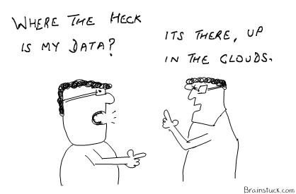
What is Cloud Computing? (2/2)
Rapidly provisioned and released.
Minimal Management Effort of Service Providers
Cloud computing is the delivery of hosting services that are provided to a client over the Internet.
Enable large-scale services without up-front investment.

Slide 6
Deployment Model
There are four primary cloud deployment models :
Public Cloud
Private Cloud
Community Cloud
Hybrid Cloud

Slide 7
Deployment Models (Public Cloud)
Public clouds are owned by cloud service providers who charge for the use of cloud resources.
Basic characteristics:
Homogeneous infrastructure, Common policies
Shared resources and multi-tenancy
Leased or rented infrastructure
Economies of scale
AWS/EC2 (Amazon)
Azure (Microsoft)
Google Cloud Platform.

Slide 8
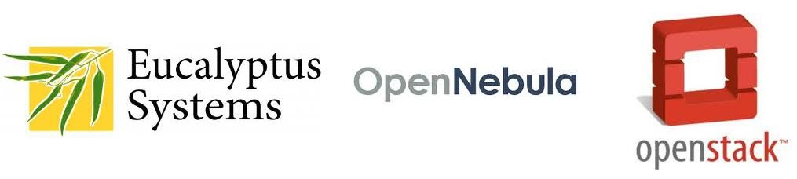
Deployment Models (Private Cloud)
The cloud infrastructure belongs to and is operated by only one organization.
Basic characteristics :
Heterogeneous infrastructure; Customized policies
Dedicated resources
In-house infrastructure; End-to-end control
Examples include:

Slide 9
Deployment Models
Community cloud
The cloud infrastructure is shared by several organizations and supports a specific community that has shared concerns (e.g., mission, security requirements, policy and compliance considerations).
Hybrid cloud
The cloud infrastructure is a composition of two or more clouds (private, community, or public) that remain unique entities but are bound together by standardized or proprietary technology that enables data and application portability.

Slide 10
Types Of Cloud Services

Slide 11
Types of Cloud Services
Infrastructure as a Service (IaaS):
VMs, Servers, disks
Platform as a Service (PaaS):
Software as a Service (SaaS):
Web, MapReduce
Email, GitHub
Public vs private clouds:
Shared across arbitrary orgs/customers vs internal to one organization

Slide 12
Types of Cloud Services
Infrastructure as a Service (IaaS)
Platform as a Service (PaaS)
Software as a Service (SaaS)
SaaS
Applications
Packaged Software
Platform
OS & Application Stack
Infrastructure
Servers · Storage
Network
PaaS
Platform
OS & Application Stack
Infrastructure
Servers · Storage
Network
IaaS
Infrastructure
Servers · Storage
Network

Slide 13
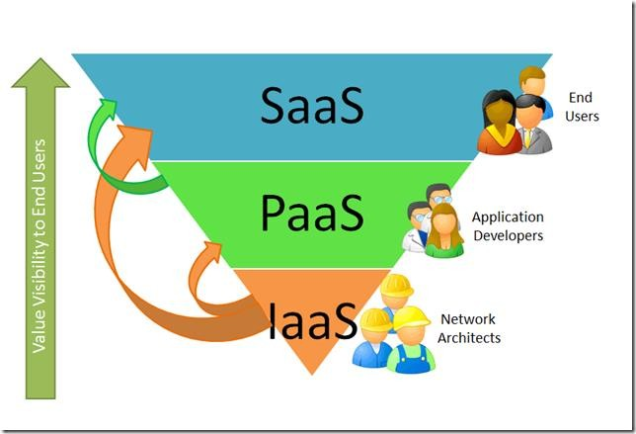
Types of Cloud Services
Image credit:
http://blogs.msdn.com/b/seliot/archive/2010/03/04/what-the-heck-is-cloud-computing-another-re-look-with- pretty-pictures.aspx

Slide 14
General Cloud Architecture
Web Server
Java, PHP, JS, …
Analytics UIs
Hive, Pig, HiPal, …
Metering + Billing
Security (e.g. IAM)
Cache
memcached, TAO, …
Other Services model serving, search, Unicorn, Druid, …
Analytics Engines MapReduce, Dryad, Pregel, Spark, …
Operational Stores SQL, Spanner, Dynamo, Cassandra, BigTable, …
Message Bus
Kafka, Kinesis, …
Metadata
Hive, AWS Catalog, …
Coordination
Chubby, ZK, …
Distributed Storage
Amazon S3, GFS, Hadoop FS, …
Resource Manager
EC2, Borg, Mesos, Kubernetes, …

Slide 15

General Cloud Architecture (Web Application)
Web Server
Java, PHP, JS, …
Analytics UIs
Hive, Pig, HiPal, …
Metering + Billing
Security (e.g. IAM)
Cache
memcached, TAO, …
Other Services model serving, search, Unicorn, Druid, …
Analytics Engines MapReduce, Dryad, Pregel, Spark, …
Operational Stores SQL, Spanner, Dynamo, Cassandra, BigTable, …
Message Bus
Kafka, Kinesis, …
Metadata
Hive, AWS Catalog, …
Coordination
Chubby, ZK, …
Distributed Storage
Amazon S3, GFS, Hadoop FS, …
Resource Manager
EC2, Borg, Mesos, Kubernetes, …

Slide 16

General Cloud Architecture (Analytics Warehouse)
Web Server
Java, PHP, JS, …
Analytics UIs
Hive, Pig, HiPal, …
Metering + Billing
Security (e.g. IAM)
Cache
memcached, TAO, …
Other Services model serving, search, Unicorn, Druid, …
Analytics Engines MapReduce, Dryad, Pregel, Spark, …
Operational Stores SQL, Spanner, Dynamo, Cassandra, BigTable, …
Message Bus
Kafka, Kinesis, …
Metadata
Hive, AWS Catalog, …
Coordination
Chubby, ZK, …
Distributed Storage
Amazon S3, GFS, Hadoop FS, …
Resource Manager
EC2, Borg, Mesos, Kubernetes, …

Slide 17
Why Cloud Computing
Average server utilization is 5% to 20%.
Peak workload exceeds the average by factors of 2 to 10.
Users provision for the peak.
Peak loads may occur based on the time of day or based on other factors (e.g. photo sharing after the holidays, drop/add within two weeks of start of term, etc.)

Slide 18
Why Cloud Computing
Cloud computing is Utility Computing
Cloud services are controlled and monitored by the cloud provider through a pay-per-use business model.
An ideal cloud computing platform is:
efficient in its use of resources
scalable
elastic
self-managing
highly available and accessible
inter-operable and portable

Slide 19
Why Cloud Computing
Resource efficiency (Scalability): computing and network resources are pooled to provide services to multiple users. Resource allocation is dynamically adapted according to user demand.
Elasticity: computing resources can be rapidly and elastically provisioned to scale up, and released to scale down based on consumer’s demand.

Slide 20
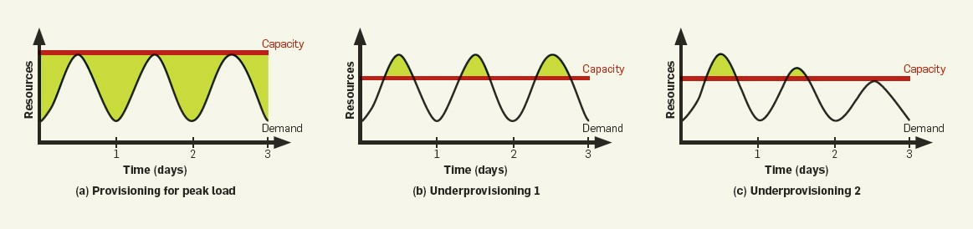
Over or Under-Provisioning
Less and less demand.
Shaded area represents requests not served.
Shaded area is unused capability.

Slide 21
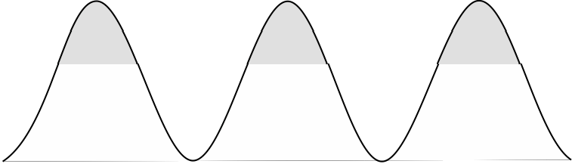

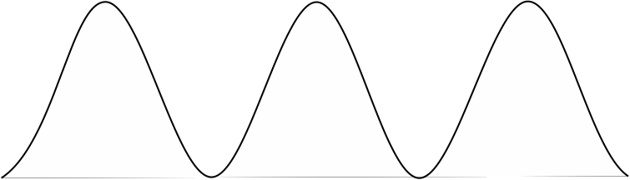

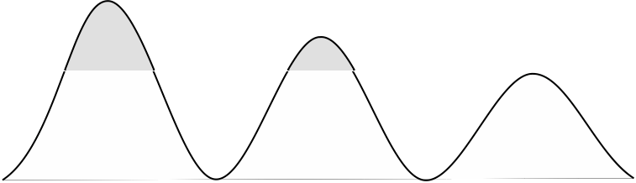
Dynamic Provisioning
In traditional computing model, two common
problems :
- Underestimate system utilization which result in under provision
Loss Revenue
Capacity
Resources
Demand
3
Resources
Capacity
1
2
Demand 3
Loss Users
2
Resources
Capacity
1
Time (days)
Demand 3
1
2

Slide 22
Cloud Economics: For Users
Elasticity:
» Using 1000 servers for 1 hour costs the same as 1 server for 1000 hours
» Same price to get a result faster!
Resources
Resources
Time
Time

Slide 23
Why Cloud Computing
Self-managing services: a consumer can provision cloud services, such as web applications, server time, processing, storage and network as needed and automatically without requiring human interaction with each service’s provider
Accessible and highly available: cloud resources are available over the network anytime and anywhere and are accessed through standard mechanisms that promote use by different types of platform (e.g., mobile phones, laptops, and PDAs).

Slide 24
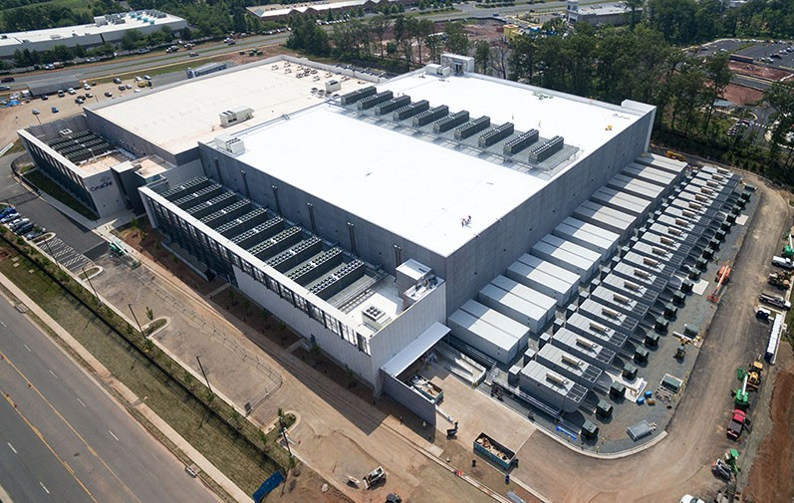
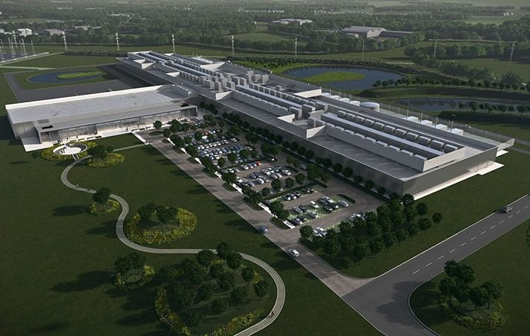
Cloud Computing Economies of Scale
Economies of scale:
» Purchasing, powering, managing machines at scale gives lower per-unit costs than customers’

Slide 25
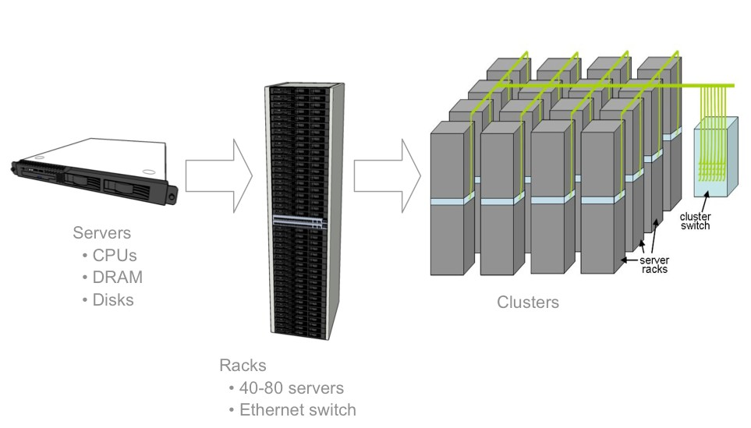
Datacenter Hardware
Rows of rack-mounted servers
Datacenters with 50 – 200K of servers and burn 10 – 100MW
Storage: distributed with compute or NAS systems
Remote storage access for many use cases (why?)

Slide 26
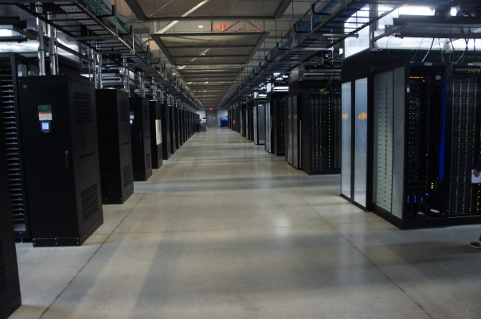
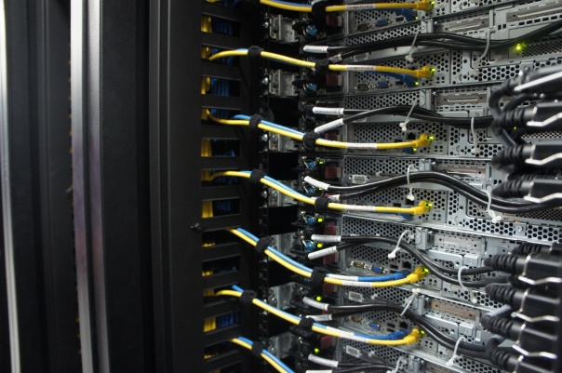
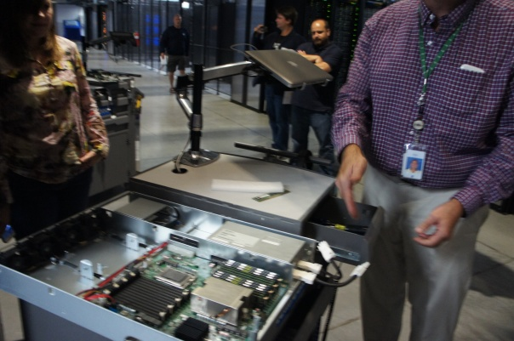
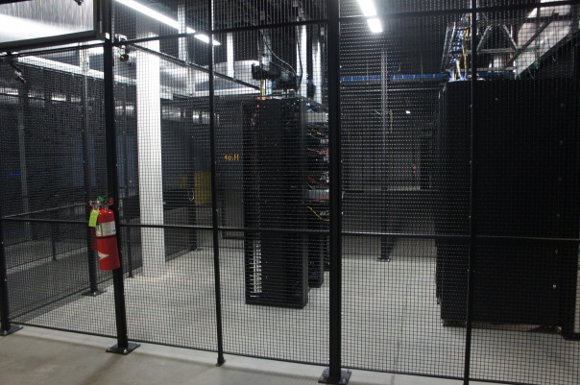
Servers
Front
Back
In
Some highly secure (e.g., financial info)
Notes:
Copyright?

Slide 27
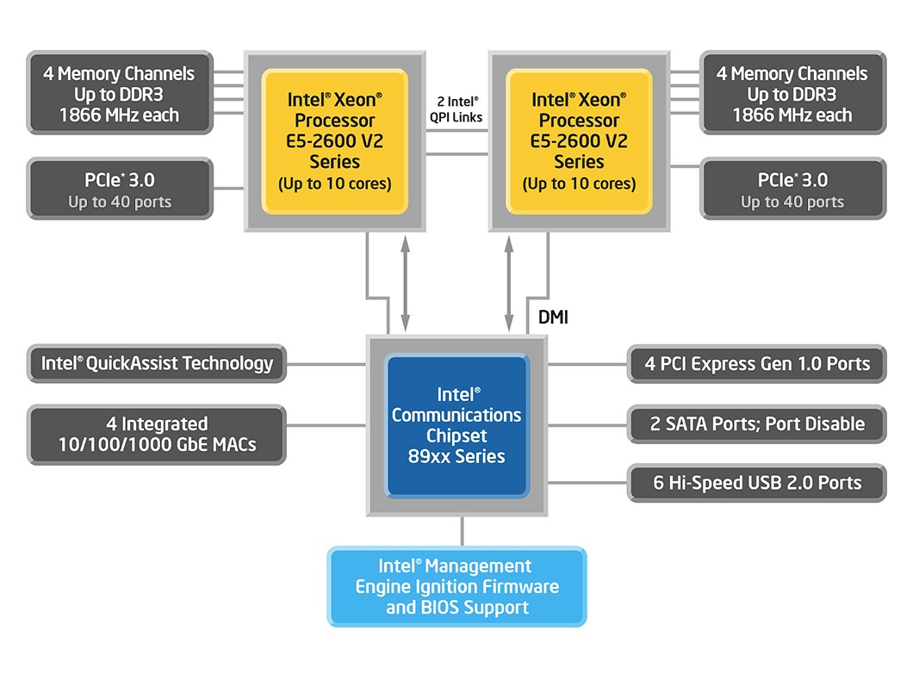
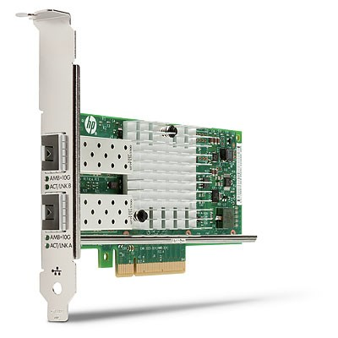
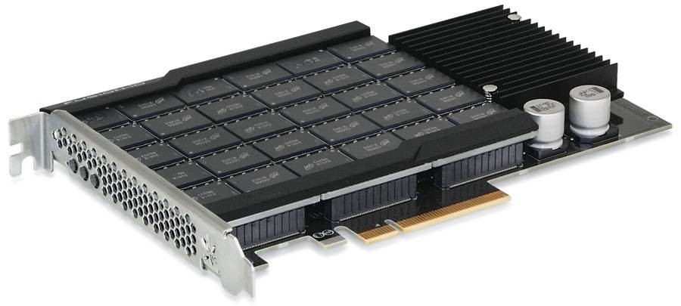
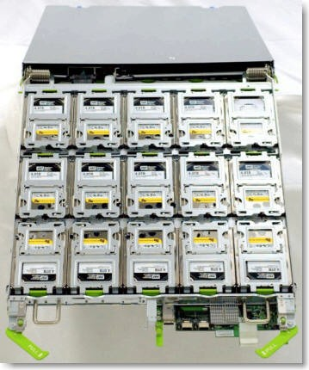
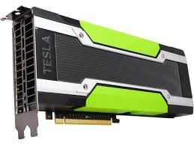
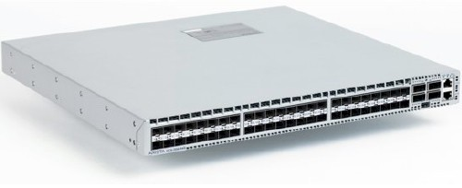
Datacenter Hardware
2-socket server
>10GbE NIC
Flash Storage
JBOD disk array
GPU/accelerators
>10GbE Switch

Slide 28
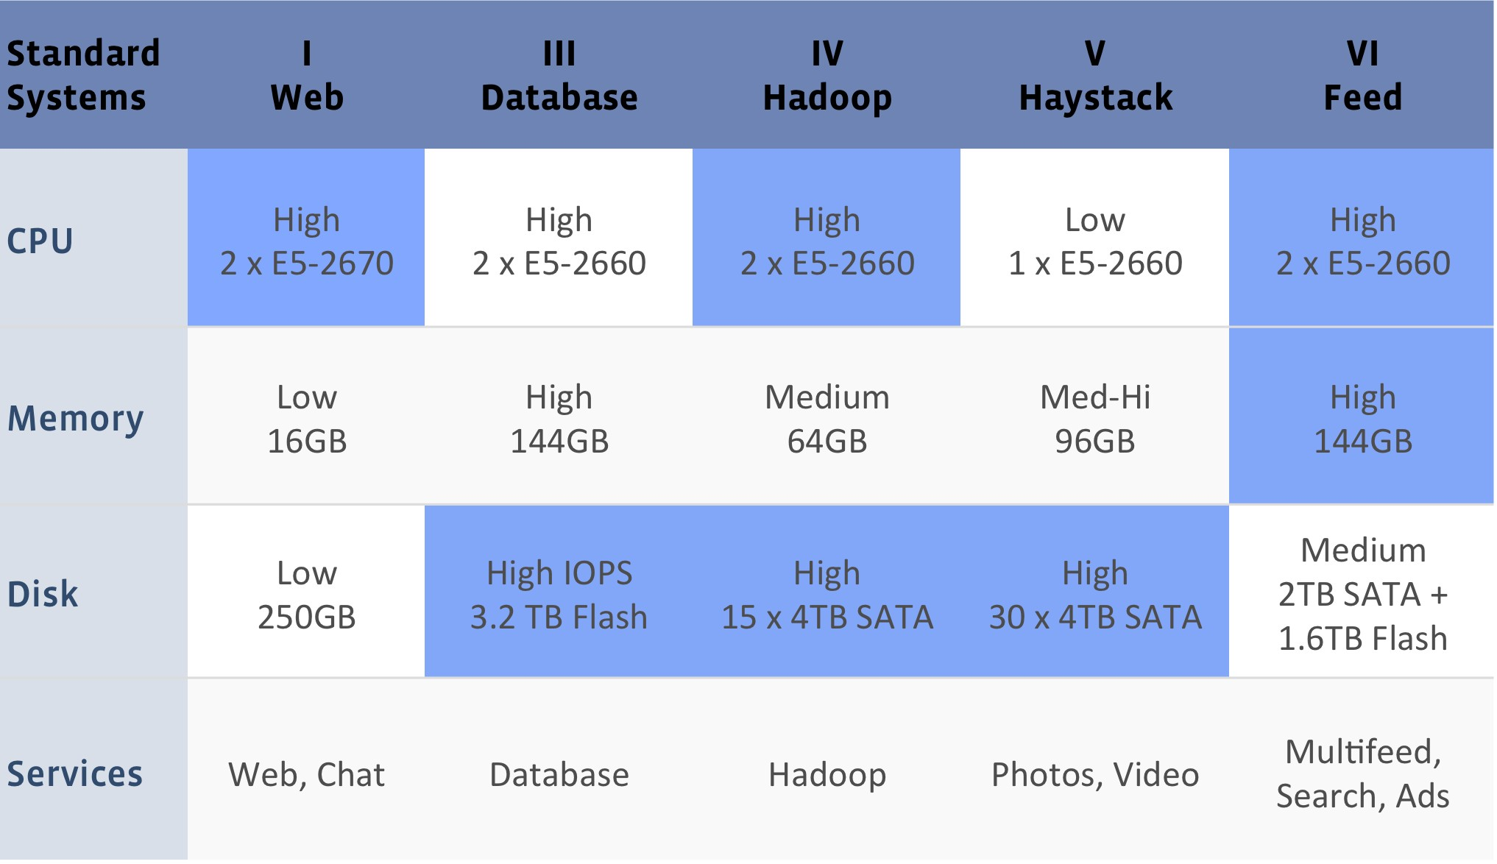
Hardware Heterogeneity
[Facebook server configurations]
Custom-design servers
Configurations optimized for major app classes
Few configurations to allow reuse across many apps Roughly constant power budget per volume

Slide 29
Total Cost of Ownership (TCO)
TCO = capital (CapEx) + operational (OpEx) expenses
Operators perspective
CapEx: building, generators, A/C, compute/storage/net HW
Including spares, amortized over 3 – 15 years
OpEx: electricity (5-7c/KWh), repairs, people, WAN, insurance, …
Users perspective
CapEx: cost of long term leases on HW and services OpeEx: pay per use cost on HW and services, people
30

Slide 30

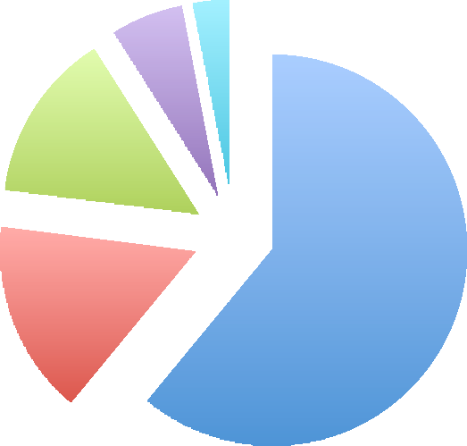




Operator’s TCO Example
6%
3%
Servers Energy Cooling Networking Other
14%
16%
61%
[Source: James Hamilton]
Hardware dominates TCO, make it cheap Must utilize it as well as possible
31

Slide 31
How Much Does It Cost 1/2
2 Networking – per GiB and month
→Data going in: $0.10 / GiB
←Data coming out:
0 .. 1 GiB: $0
< 10 TB: $0.15 / GiB← max: use for estimates
■
11.. 49 TB: $0.11 / GiB
50 .. 149 TB: $0.09 / GiB
> 150 TB: $0.08 / GiB
■

Slide 32
How Much Does It Cost 2/2
3 Storage – per GiB and month
EBS: $0.10 / GiB * month
S3: $0.15 / GiB * month

Slide 33
Questions?

